Slide 1
American Union Representation 1983 – 2022: A Brief Data Story

Slide 2
Data Sources
Data series were obtained from the Bureau of Labor Statistics
Retrieval tools for these data are dated
Data required substantial cleaning and processing
Union representation and work stoppages data were queried
Historical series do not overlap; timeframe shared by all variables limited to 1983 – 2022

Slide 3
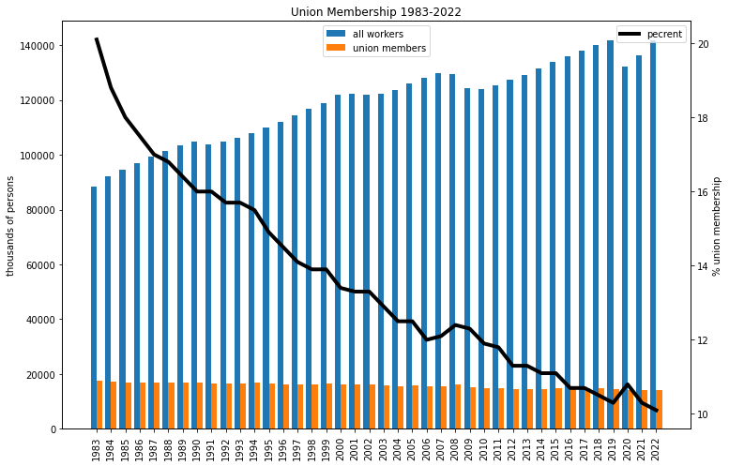
Union Membership
Overall union membership declined – even more as % of workforce

Slide 4
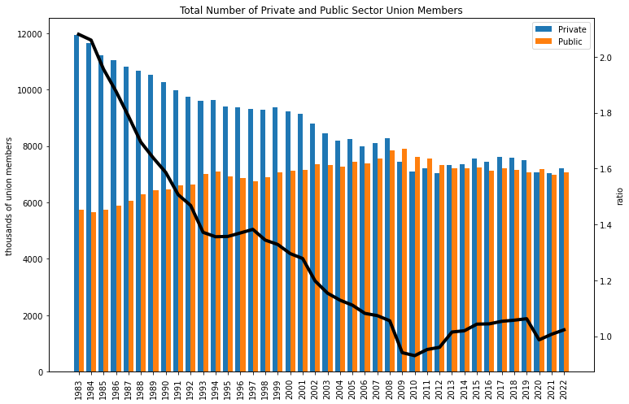
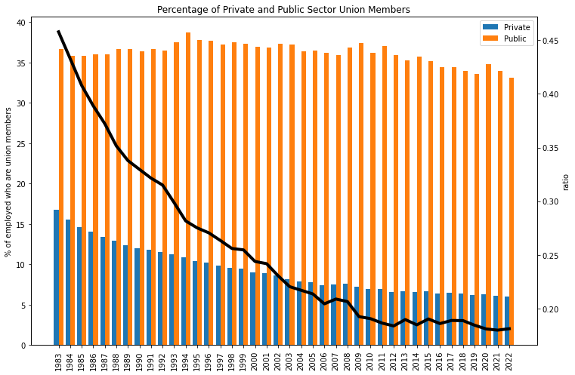
Public vs Private Sector
The entirety of the decline in union membership can be attributed to the private sector.

Slide 5
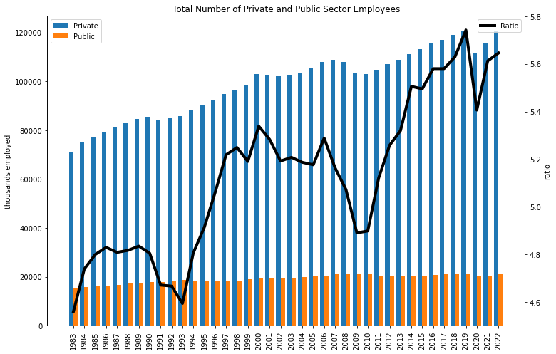
Private vs Public Employment
Over the same time period, public sector employment has remained relatively static; private sector employment has grown

Slide 6
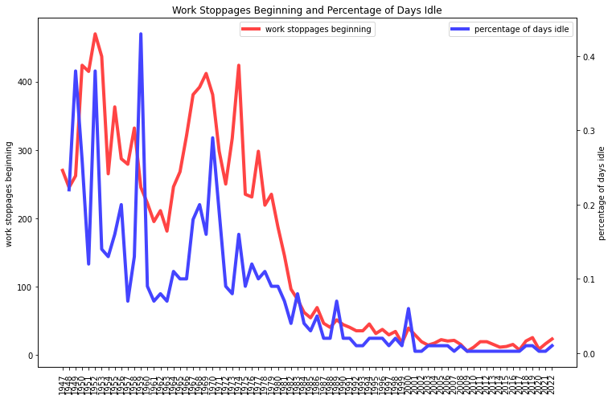
Work Stoppages
BLS data on work stoppages spans 1947 – 2022
Greatly diminished strike and stoppage activity

Slide 7
Principal Observations
Union membership has declined in private sector; stable in public
As percentage, private sector union membership declined from 16.8% to 6.0%
Only slight growth in public sector employment since 1983
Decline in work stoppages since the late 1940’s largely precedes the decline in private sector union membership
Composition of public sector union membership merits further exploration

